Slide 1
SENTIMENT ANALYSIS IN MARKETING
Phase-2 (Innovation)

Slide 2
NAME : Shevitha D
YEAR : III-year
NM ID : au513521104046
EMAIL ID : shevithadeena@gmail.com

Slide 3
INTRODUCTION
Sentiment analysis is a form of text research that uses a mix of statistics, natural language processing (NLP), and machine learning to identify and extract subjective information -for instance, a reviewer’s feelings, thoughts, judgments, or assessments about a particular topic, event, or a company and its activities
This analysis type is also known as opinion mining (with a focus on extraction) or affective rating. Some specialists prefer the terms sentiment classification and extraction. Regardless of the name, the goal is the same: to know a user or audience opinion on a target object by analyzing a vast amount of text from various sources.

Slide 4
TYPES
Subjectivity classification : Subjectivity classification divides fragments of text into objective and subjective or opinionated.
Polarity classification : Opinionated pieces of text can be further divided into negative and positive, using polarity classification.
Aspect-based sentiment analysis : Aspect-based or feature-based sentiment analysis is a multistep process aiming at detecting and extracting sentiments toward a specific component of a product or service.
Fine-grained sentiment analysis : The term is often used as a synonym for aspect-based sentiment analysis, multiclass polarity classification, or subsentence-level sentiment analysis — as opposed to coarse-grained opinion mining performed at document and sentence levels.

Slide 5
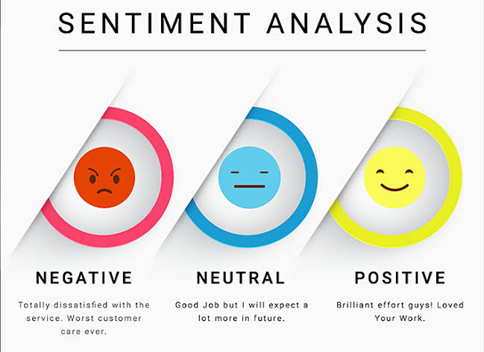
SENTIMENT ANNOTATION
The second step is to assign sentiment tags (positive, neutral, negative, etc.) to words and phrases. Attribute-based and fine-grained types of sentiment analysis will require more labels — and more textual data — to produce accurate results. Keep in mind that sentiment labeling is considered reliable if it’s made by more than one annotator.

Slide 6
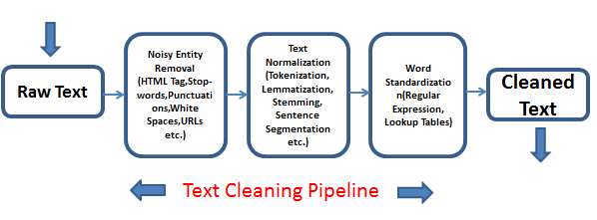
Text cleansing
Reviews and comments typically contain a lot of irrelevant and excessive information that can negatively affect a model’s precision. So, before feeding the dataset to an algorithm, you must get rid of noises, stop words (articles, pronouns, etc.), and variations of the same words, transforming them into canonical form.

Slide 7
Model training and testing
Finally, your data science team proceeds to train an ML model and evaluate its results. For this, the prepared dataset is split into training and testing parts. Once the model achieves satisfactory predictions, it can be used for sentiment detection and classification in new, unlabeled reviews.

Slide 8
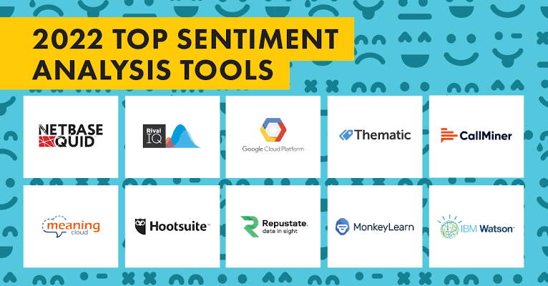
Sentiment analysis tools and APIs
InMoment
Clarabridge
Azure AI Language
Cloud Natural Language API
IBM Watson NLP

Slide 9
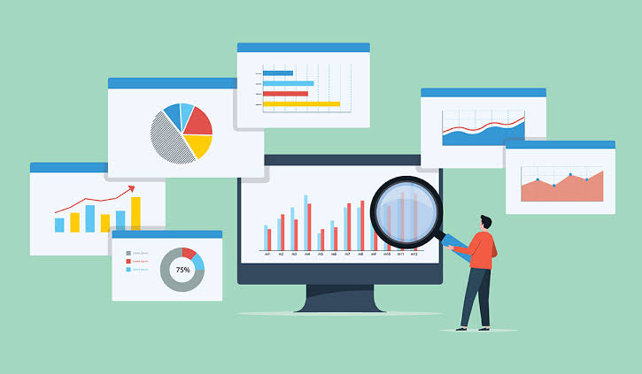
Brand monitoring
If the Internet was a mountain river, then analyzing user-generated content on social media and other platforms is like fishing during the trout-spawning season. People enjoy sharing their points of view regarding the latest news, local and global events, and their experience as customers. Twitter and Facebook are favorite places for daily comment wars and spirited (to put it mildly!) conversations. News about celebrities, entrepreneurs, and global companies draws thousands of people within a couple of hours after being published on Reddit. Media giants like Time, The Economist, and CNBC, as well as millions of blogs, forums, and review platforms, flourish with content on various topics.

Slide 10
Why not use these data sources to monitor what people think and say about your organization and why they perceive you this way? Sentiment analysis of brand mentions allows you to keep current with your credibility within the industry, identify emerging reputational crises, and respond to them quickly. You can compare this month’s results and those from the previous quarter, for instance, and find out how your brand image has changed during this time
It’s not only important to know social opinions about your organization but also to define who is talking about you, whether the industry influences your brand, and in what context. What’s more exciting sentiment analysis software does all of the above in real time and across all channels

Slide 11
COMPETITIVE RESEARCH
There is one thing for sure you and your competitors have in common – a target audience. You can track and research how society evaluates competitors just as you analyze their attitude toward your business. What do customers value most about other industry players? Is there anything competitors lack or do wrong? Which channels do clients use to engage with other companies? Take advantage of this knowledge to improve your communication, marketing strategies, and overall service
Competitive analysis that involves sentiment analysis will help you understand your weaknesses and strengths and maybe find ways to stand out.

Slide 12
FLAME DETECTION AND CUSTOMER PRIORITIZATION
Hospitality brands, financial institutions, retailers, transportation companies, and other businesses use sentiment classification to optimize customer care department work. With text analysis platforms like IBM Watson Natural Language Understanding or MonkeyLearn, users can automate the classification of incoming customer support messages by polarity, topic, aspect, and priority. Then, queries are sent to dedicated , and new or repeat customers

Slide 13
Since it’s better to put out a spark before it turns into a flame, new messages from the least happy and most angry customers are processed first. Satalytics, for example, groups feedback by device, customer journey stage, and new or repeat customers.

Slide 14
MARKET RESEARCH AND INSIGHTS INTO INDUSTRY TRENDS
As we said before, social media sites and forums are sources of information on any topic. People discuss news and products and write about their values, dreams, everyday needs, and events. And they do this voluntarily 24/7. With sentiment analysis, marketers can track and study consumer behavior patterns in real time to predict future trends and help management make informed decisions.

Slide 15
WORKFORCE ANALYTICS AND EMPLOYEE ENGAGEMENT MONITORING
Some organizations go beyond using sentiment analysis for market research or customer experience evaluation, applying it internally for HR-related processes. These companies measure employee satisfaction and detect factors that discourage team members and eventually reduce their performance. Specialists automate the analysis of employee surveys with sentiment analysis software, which allows them to address problems and concerns faster. Human resource managers can detect and track the general tone of responses, group results by departments and keywords, and check whether employee sentiment has changed over time or not.

